Slide 1

NBA Player Rank: A new way to rank players
By: Eli Shepherd
Mentor: Dr. Laurie Zack
North Carolina A&T University
Department of Mathematics
Statistics Major

Slide 2

Table of contents
Background Information
Problem Statement
Objectives
Methodology
Results
Conclusion

Slide 3
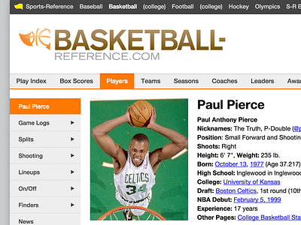
Where is the data coming from?
A basketball database site named Basketball reference (https://www.basketball-reference.com/) contains all the data that was used for research

Slide 4
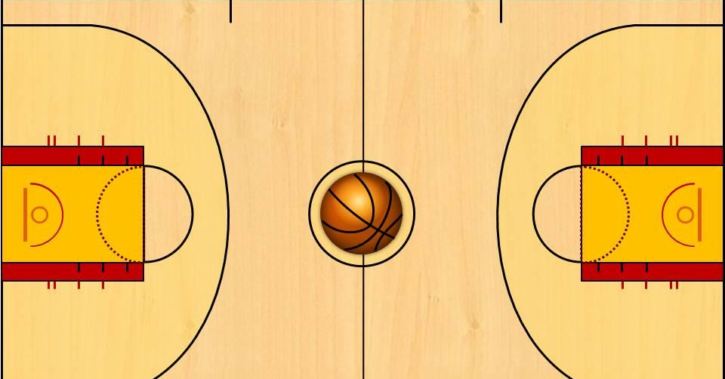
Background Information
NBA player rankings have long been a subject of debate among fans, analysts, and teams.
Traditionally, rankings have been determined using a combination of individual statistics, media votes, “expert” opinions, and accolades such as All-NBA selections and MVP awards.

Slide 5
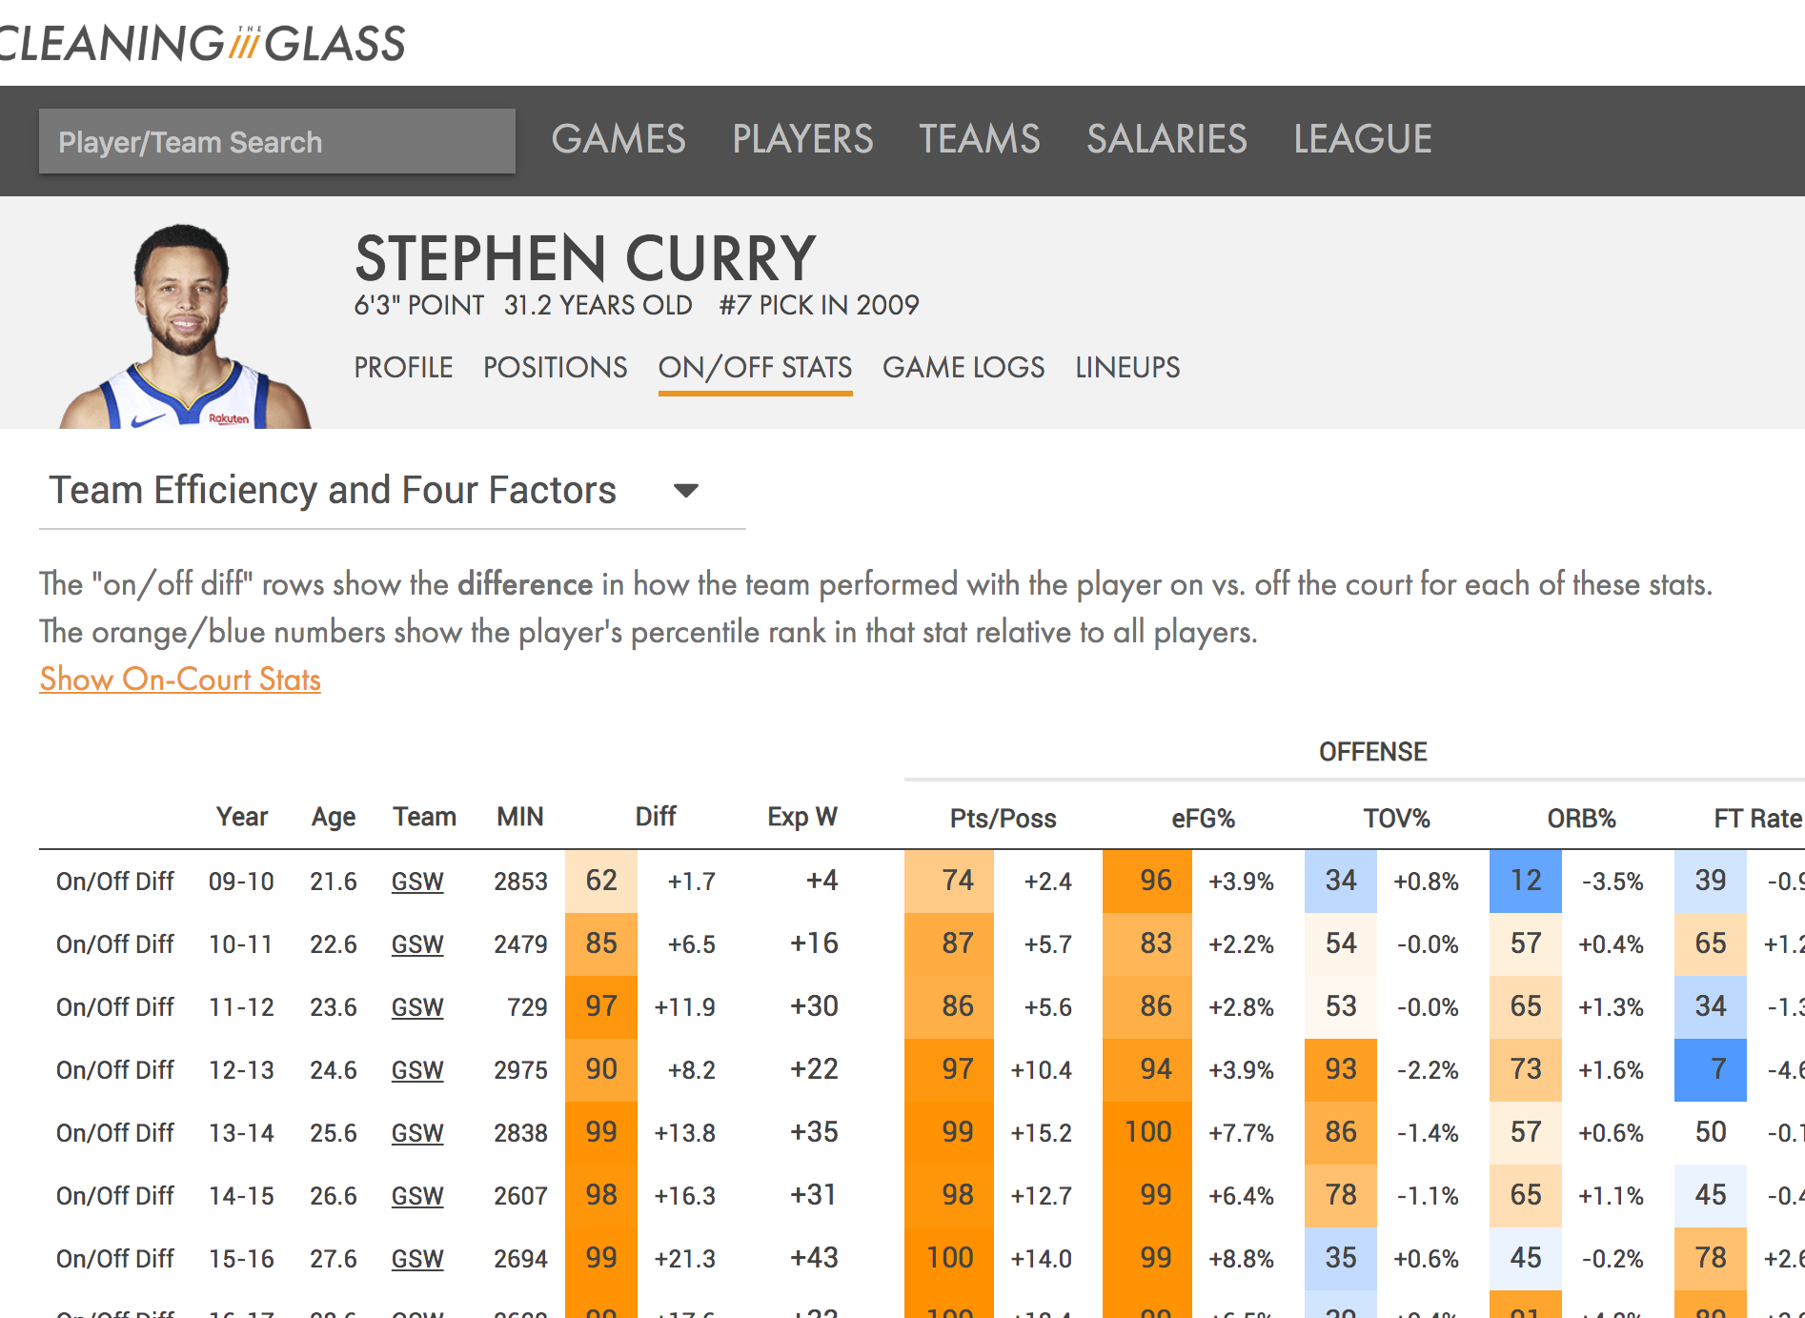
Previous studies
Data-driven approaches evaluate player performance.
Advanced stats go beyond traditional statistics

Slide 6
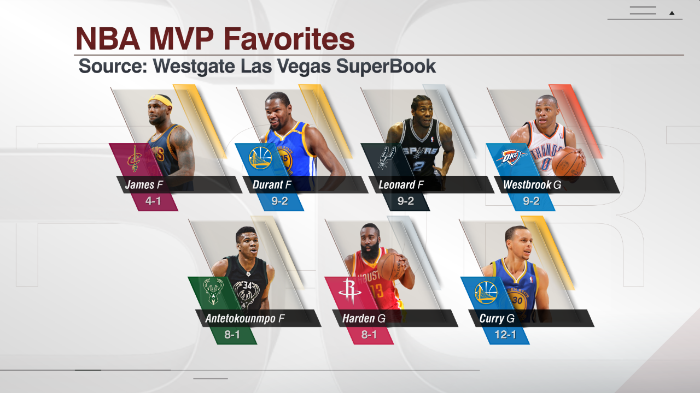
So… What’s the Problem?
No context
Narritve pushing
No comparisons

Slide 7
Objectives
Objectives
Questions
Develop a PageRank based on statistical interactions
Identify patterns in player rankings
How does the PageRank algorithm compare?
What metrics contribute most to a player’s ranking?

Slide 8


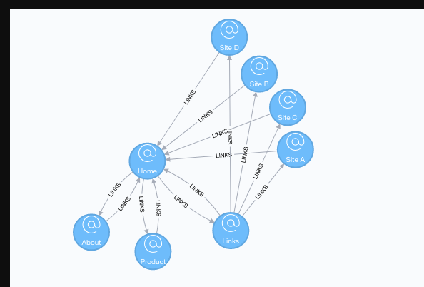
What is PageRank?
Algorithm used by Google to rank web pages.
Models a random web-surfer.

Slide 9
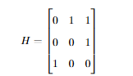
How to find PageRank
Let’s assume we have 3 webpages, A, B, and C.
This is transformed to a hyperlink matrix H.
1 if webpage i links to j
0 if i does not link to j

Slide 10
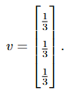
Formula
From Matrix H, a row stochastic Matrix S is form
This formula is used to find matrix G:
G = aS + (1 – a) * yv

Slide 11
Power Method
Multiply your original matrix (G) by a random initial vector.
Normalize and repeat over and over.
After obtaining G, the power method is utilized to find the dominant eigenvector.

Slide 12

How does it relate
Instead of webpages, players are nodes in a network.
Player ranking impacted by other highly ranked players.

Slide 13


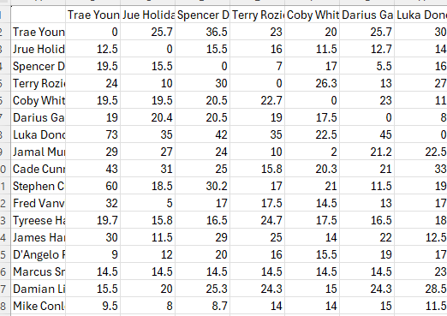
How did the data look?

Slide 14
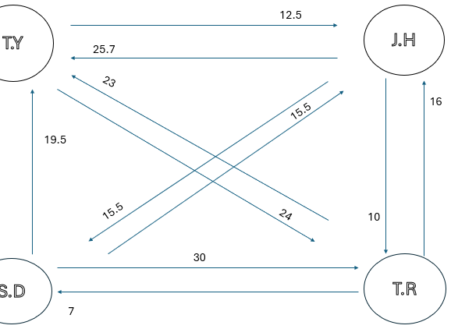
Practical Example
Note the numbers on top of and besides the links

Slide 15
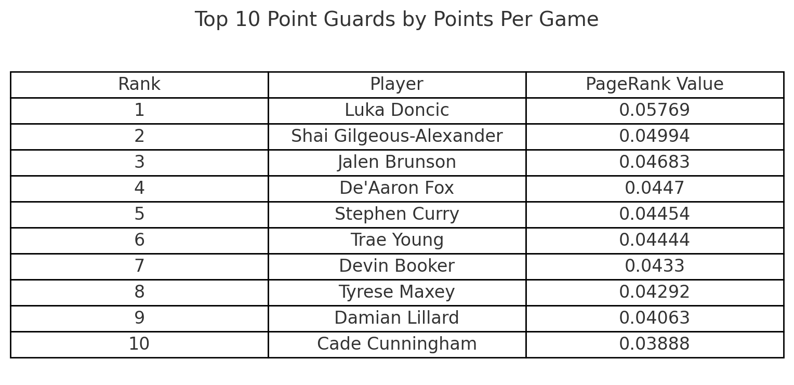
Results For Points
Actual Points Per Game
33.9
30.1
28.7
26.6
26.4
25.7
27.1
25.9
24.3
22.7

Slide 16
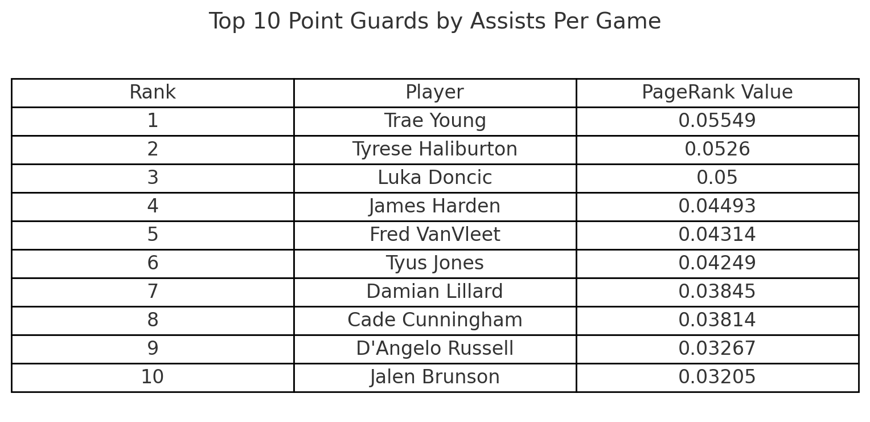
Results For Assists
Actual Assist Per Game
10.9
10.8
9.8
8.5
8.1
7.3
7.0
7.5
6.3
6.7

Slide 17
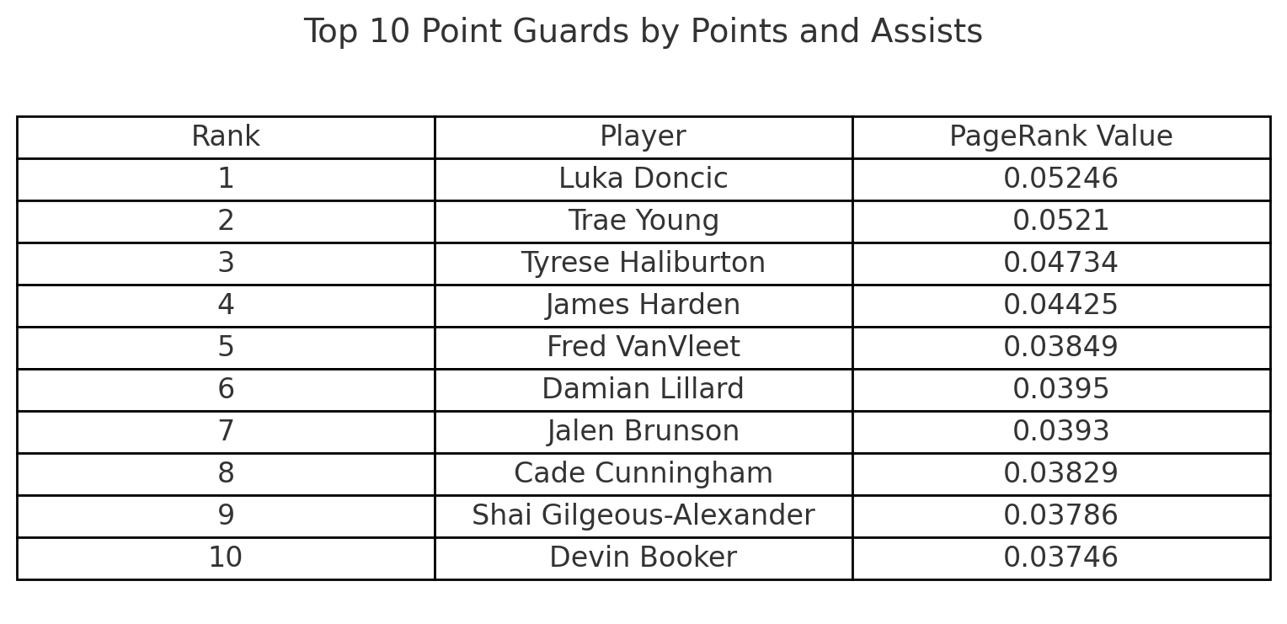
Combined Ranking

Slide 18
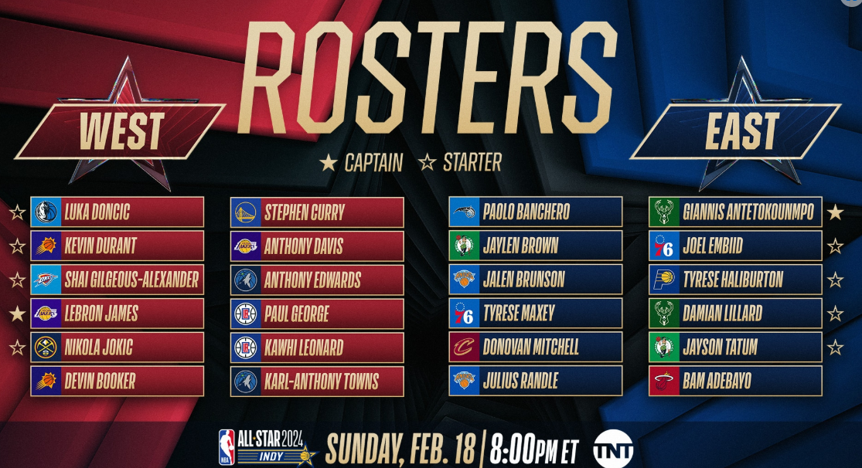

Slide 19


Conclusion
This study demonstrates the PageRank algorithm offers a more objective approach to ranking NBA players
Future refinements include adding metrics such as steals, effective field goal percentage, and Assist to Turnover ratio.

Slide 20
References
https://www.basketball-reference.com/
[Brin and Page 1998] S. Brin and L. Page, “The anatomy of a large-scale hypertextual web search engine, "Computer Networks and ISDN Systems, vol. 30, no. 1, pp. 107–117, 1998.
[Bryan and Leise 2006] K. Bryan and T. Leise, “The $25,000,000,000 eigenvector: The linear algebra behind Google,” SIAM Rev. 48:3 (2006), 569–581.]
[Page et al. 1999] L. Page, S. Brin, R. Motwani, and T. Winograd, “The PageRank citation ranking: Bringing order to the web,” tech report, Stanford InfoLab, 1999.
[Wills 2006] R. S. Wills, “Google’s PageRank: The math behind the search engine,” SIAM Rev. 48:3 (2006),569–581.
[Zack, Lamb, and Ball 2012] L. Zack, R. Lamb, S. Ball, “An application of Google’s PageRank to NFL rankings,“ Involve No.4, 463-471 (2012)

Slide 21

Special Thanks To NSF under ACE DSA grant HRD-1719488!

Slide 22





